Slide 1

Managing Ocean Data Using Databases
Practical Guide to Scientific Data Architecture, Relational SQL, and ARGO Global Floats
PAVAN KUMAR JONNAKUTI
Scientist ‘C’, ODM

Slide 2




The Ocean Data Crisis: File Chaos
Imagine this real-world scenario: You are tasked with analyzing 10,000 autonomous ARGO float profiles scattered across thousands of folders as individual NetCDF, CSV, and Excel files.
The Core Questions We Must Answer
Key Challenges with File Stores
Slow Geographic Searches: Scanning 10,000 files to find Arabian Sea profiles takes minutes or hours.
How do I find all profiles from WMOID 2902092?
How do I count total active floats instantly?
How do I feed data directly into web dashboards?
Hard Parameter Filtering: Extracting temperature between 0–500m requires opening every single file into memory.
File Corruption & Concurrency: Two scientists editing metadata simultaneously overwrite each other.

Slide 3

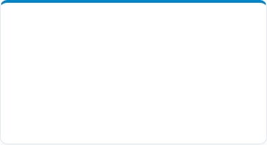
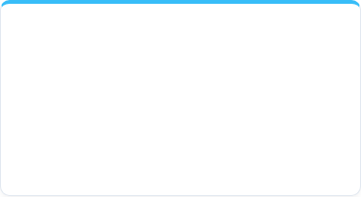

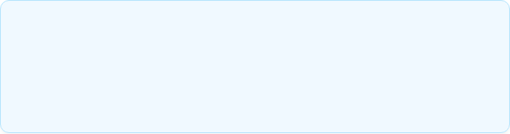
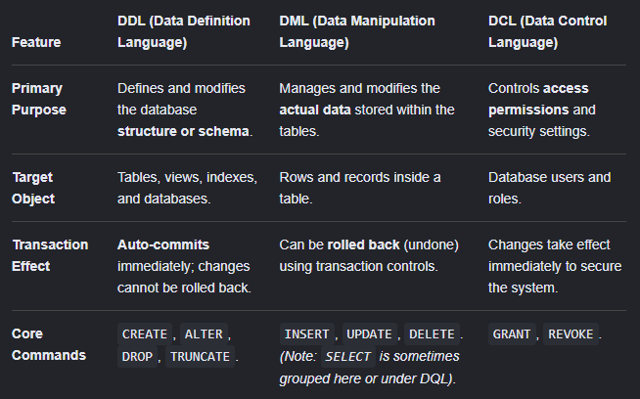

Database Fundamentals: Core Concepts & Terminology
1. The 3 Layers
2. Anatomy of a Table
3. Keys & Schemas
• Database: The structured repository storing data. • DBMS: Software engine (PostgreSQL, MySQL) managing storage & access. • SQL: Declarative language used to query data.
• Table (Entity): Grid of related records (e.g., `argo_observation`). • Column (Field): Specific data type (e.g. `salinity REAL`). • Row (Record): Individual data instance (1 measurement).
• Schema: Structural blueprint of tables. • Primary Key (PK): Unique ID for a record. • Foreign Key (FK): Link connecting related tables.
Relational (SQL) vs. Non-Relational (NoSQL)
Relational (RDBMS): Strict tabular schemas, ACID compliance, enforced keys. Ideal for structured ocean observation arrays. NoSQL (Document/Key-Value): Schema-less JSON stores. Ideal for raw, unstructured telemetry logs.
Why SQL Standards Matter
SQL is a declarative language: you specify what data you want (e.g. temperature > 25°C), and the query optimizer figures out the most efficient way to retrieve it.

Slide 4

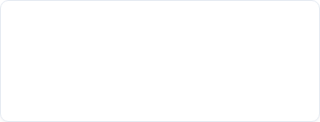

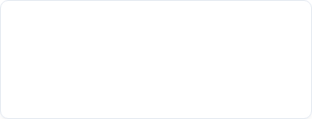
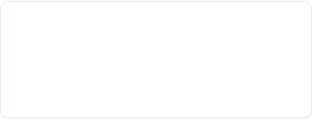
The 8 Pillars of Database Systems
1. Central Storage
2. Sub-second Search
3. Complex Filtering
Eliminates duplicated files across local hard drives. Single source of truth for all research teams.
Indexes allow searching billions of rows in milliseconds without reading the entire dataset.
Query simultaneously by date range, geographic bounding box, depth, and QC flags.
4. Concurrency
5. Data Integrity
6. API Integration
Hundreds of scientists, APIs, and models can read and write data simultaneously without crashes.
Enforces rules (e.g., salinity cannot be negative) preventing corrupted data from entering the system.
Directly connects to web apps, Python script pipelines, GIS tools, and machine learning models.

Slide 5

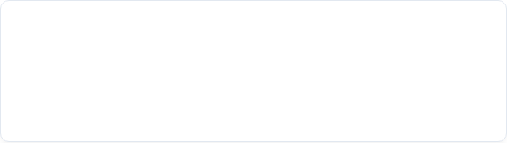

Anatomy of Oceanographic Data
Ocean data isn't just numbers—it is a structured blend of environmental observations, spatial positioning, sensor metadata, and quality flags.
Parameter | Sample Value | Data Type
Float WMOID | 2902092 | Integer (ID)
Latitude / Longitude | 15.25°N, 72.45°E | Spatial Coordinate
Profile Timestamp | 2026-08-20 06:00 | DateTime
Pressure (Depth) | 100.0 dbar | Float (Numeric)
Temperature | 27.4 °C | Float (Numeric)
Salinity | 35.6 PSU | Float (Numeric)
Dissolved Oxygen | 210.0 µmol/kg | Float (Numeric)
Data Classification Spectrum
1. Raw Telemetry: Uncalibrated signal directly from satellite link. 2. Metadata: Float model, sensor serial numbers, deployment date. 3. Quality-Controlled (QC): Data flagged for sensor drift or anomalies. 4. Derived Products: Interpolated gridded fields (e.g., RG-Argo Climatology).
Scale Insight: Over 4,000 active ARGO floats transmit profile data every 10 days, generating millions of records annually. File systems crumble under this volume.

Slide 6




Deconstructing the Database Architecture
A Database is an organized collection of structured data. A DBMS (Database Management System) is the software engine that interacts with users, applications, and the database itself.
Popular RDBMS Engines
• PostgreSQL: Open-source, gold standard for scientific & GIS spatial data (PostGIS). • MySQL / MariaDB: Lightweight, widely deployed in web services. • SQLite: Serverless, embedded file-based relational database.
Data to User Value Chain
ARGO Telemetry ↓ PostgreSQL Database (DBMS) ↓ FastAPI / REST Service ↓ Web Dashboard / Python Client ↓ Researcher / Decision Maker
Relational vs. NoSQL
• Relational (SQL): Strict schema, tables, foreign keys. Perfect for ARGO profiles. • NoSQL (MongoDB): Unstructured document store. Good for raw JSON telemetry logs.

Slide 7

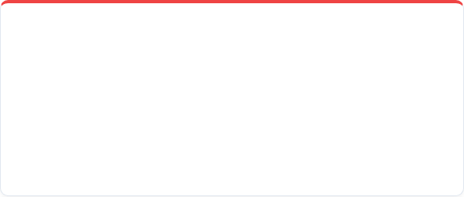

Database Design: Normalizing ARGO Data
The Pitfall: Storing everything in one giant flat table repeats float metadata millions of times. The Solution: Database Normalization (splitting data into logical related tables).
Bad Approach: Single Flat Table
Good Approach: Normalized Relational Tables
WMOID | Lat | Lon | Date | Depth | Temp
2902092 | 15.25 | 72.45 | 2026-08-20 | 10m | 28.1
2902092 | 15.25 | 72.45 | 2026-08-20 | 50m | 27.8
2902092 | 15.25 | 72.45 | 2026-08-20 | 100m | 27.4
1. ARGO_PROFILE Table (Metadata)
profile_id (PK) | wmoid | date | lat | lon
10001 | 2902092 | 2026-08-20 | 15.25 | 72.45
2. ARGO_OBSERVATION Table (Measurements)
Redundant storage of WMOID, Lat, Lon, Date for every single depth layer!
obs_id | profile_id (FK) | depth | temp | salinity
1 | 10001 | 10 dbar | 28.1 | 35.4
2 | 10001 | 50 dbar | 27.8 | 35.5

Slide 8





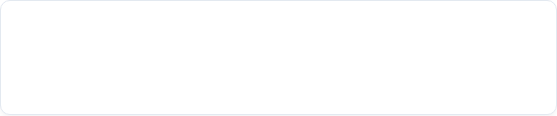
Relational Architecture: 1-to-Many Model
ARGO_FLOAT
ARGO_PROFILE
ARGO_OBSERVATION
1 : Many
1 : Many
🔑 wmoid (PK) • float_type • deploy_date • status
🔑 profile_id (PK) 🔗 wmoid (FK) • cycle_number • profile_date • latitude, longitude
🔑 obs_id (PK) 🔗 profile_id (FK) • pressure (dbar) • temperature (°C) • salinity (PSU)
Primary Key (PK)
Foreign Key (FK)
A unique identifier for every row in a table. Guaranteed to be non-null and distinct (e.g., `profile_id = 10001`).
A field referencing the Primary Key of another table. Maintains relational integrity across the profile and observation levels.

Slide 9

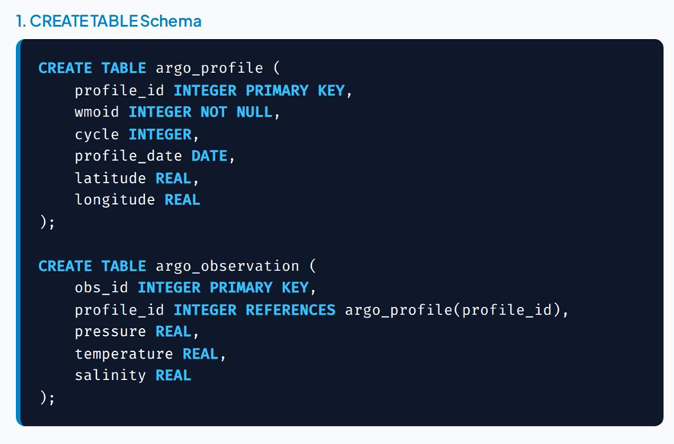
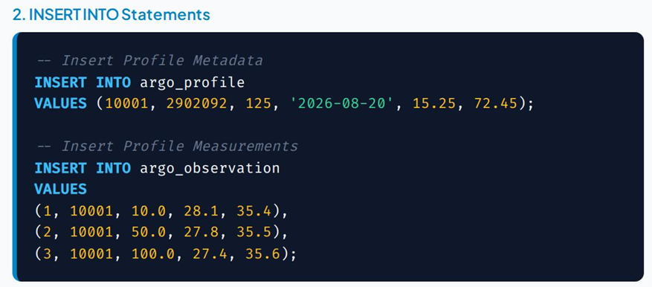

SQL Essentials I: Table Creation & Data Ingestion
Integrity Guarantee: SQL prevents inserting observations for a `profile_id` that doesn't exist in `argo_profile`!

Slide 10

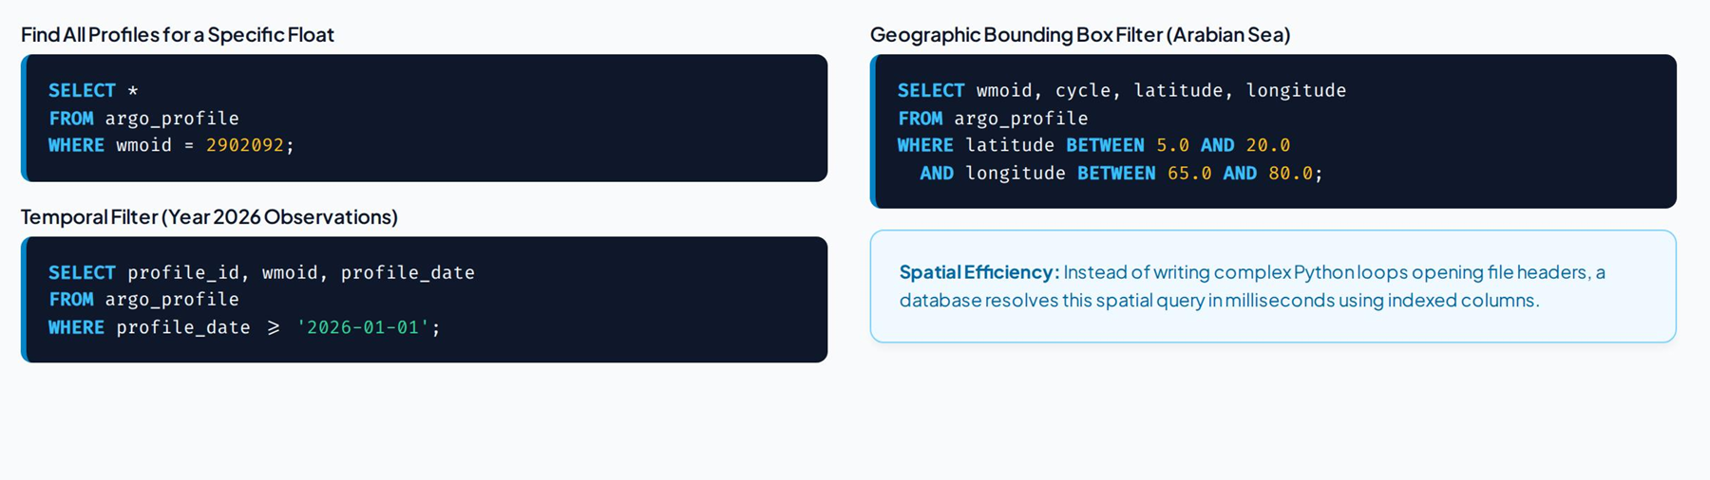
SQL Essentials II: Filtering & Spatial Bounding

Slide 11

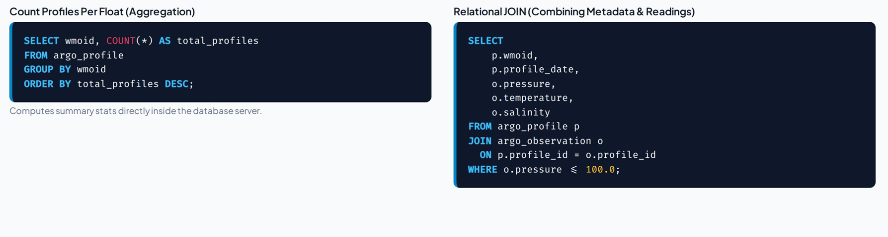
SQL Essentials III: Aggregations & Relational Joins

Slide 12

Databases vs. NetCDF Files: A Hybrid Synergy
Feature / Capability | Files (NetCDF / CSV / HDF5) | Relational Database (PostgreSQL)
Primary Purpose | Multidimensional array storage & archival | Fast indexing, querying, metadata & APIs
Search Speed | Slow (Must open and read files) | Blazing Fast (B-Tree & Spatial Indexes)
Concurrent Users | Poor (Risk of file locking/corruption) | Excellent (ACID Compliant Concurrency)
Data Integrity Rules | Manual (Application level checks) | Enforced (Constraints & Foreign Keys)
Web App Integration | Requires heavy preprocessing | Direct REST API / SQL connection
The Modern Architecture Solution: Co-existence
Databases do not replace NetCDF files! Instead, databases store profile metadata, spatial points, and indices. When a user requests raw binary ocean grids, the database provides the exact file path link to the NetCDF store.

Slide 13

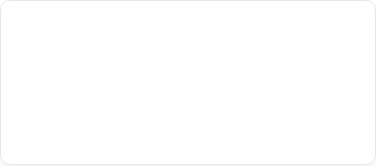

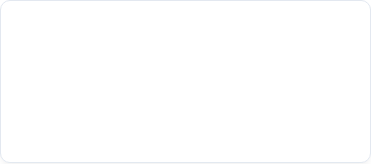
Real-World Applications in Oceanography
1. Global Data Portals
2. Real-Time Telemetry
3. Machine Learning Pipelines
Powers web portals like NOAA ERDDAP, Copernicus Marine Service, and INCOIS where users filter ocean observations by custom polygons.
Incoming satellite feeds from floats, gliders, and moorings automatically trigger QC script checks and push observations into live DB tables.
SQL pipelines extract clean, quality-controlled temperature profiles directly into PyTorch or TensorFlow ocean forecasting models.

Slide 14

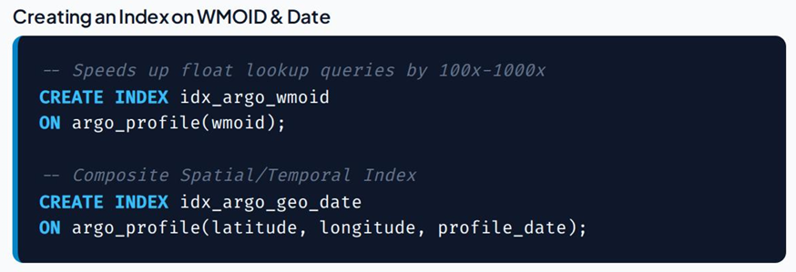


The Secret Sauce: Database Indexing Mechanics
The Book Index Analogy
Imagine looking for the term "Salinity Anomaly" in a 1,000-page oceanography textbook. • Sequential Scan (No Index): Reading every single page from page 1 to 1000. • B-Tree Index: Turning straight to the index at the back, finding page 742, and jumping straight there instantly.
Performance Note: Without indexes, a query on 10 million rows scans 10M records. With B-Tree indexes, it finds the record in ~20 operations.

Slide 15







End-to-End Ocean Data System Architecture
Ingestion & QC
Relational DBMS
REST API
Python / NetCDF Parsing
PostgreSQL + PostGIS
FastAPI / Python

Slide 16


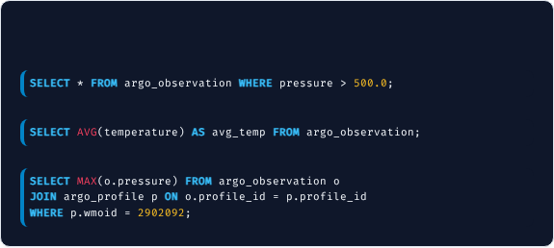
Interactive Challenge & Solutions
Student Exercise Queries
Answer Key
Given the `argo_profile` and `argo_observation` tables, write SQL queries for:
1. Filter by Pressure
1.
Find all observations deeper than 500.0 dbar.
2.
Calculate the average water temperature across all observations.
2. Average Temperature Aggregation
3.
Find the maximum pressure reached by float 2902092.
3. Max Pressure with JOIN

Slide 17


Summary & Next Steps
Key Takeaways
Recommended Hands-On Lab
Databases transition scientific data management from fragile file folders to robust, scalable platforms.
Step 1: Install PostgreSQL with PostGIS extension. Step 2: Use Python (`netCDF4` + `psycopg2`) to parse raw ARGO `.nc` files. Step 3: Ingest float profiles into relational tables. Step 4: Build a Streamlit web dashboard querying the database in real-time.
Relational schemas eliminate redundant data via normalized tables connected by Primary and Foreign Keys.
SQL empowers researchers to execute instantaneous spatial, temporal, and conditional subsetting.

